Slide 1
Current Measurement using ARDUINO
Dr. G. V. Prasanna Anjaneyulu
From
Dr.G.V.Prasanna Anjaneyulu

Slide 2
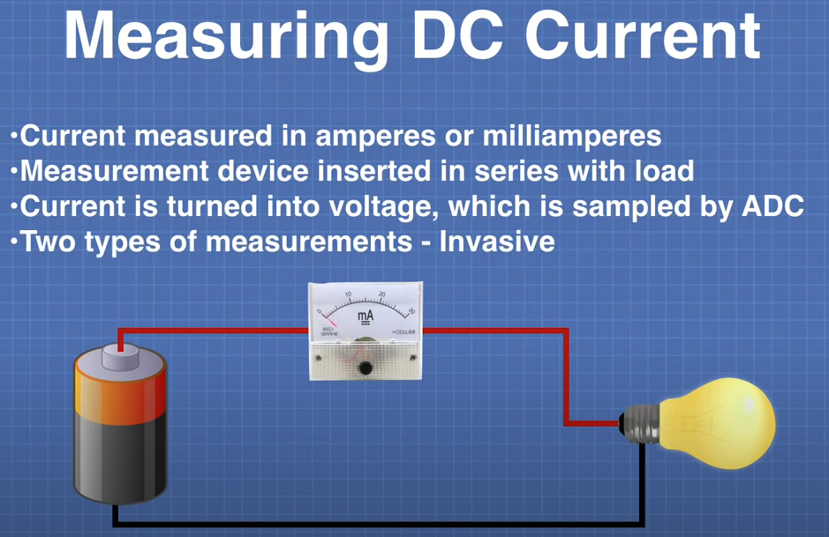
Dr. G. V. Prasanna Anjaneyulu
Current Measurement by Dr.GVP

Slide 3
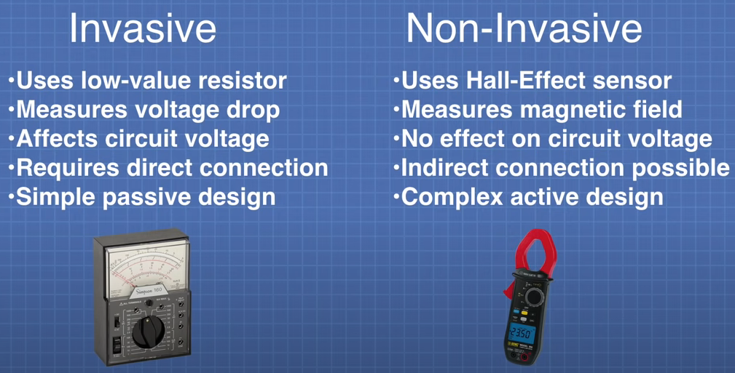
Dr. G. V. Prasanna Anjaneyulu
Current Measurement by Dr.GVP

Slide 4
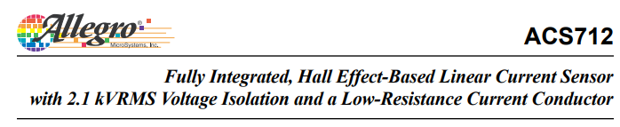
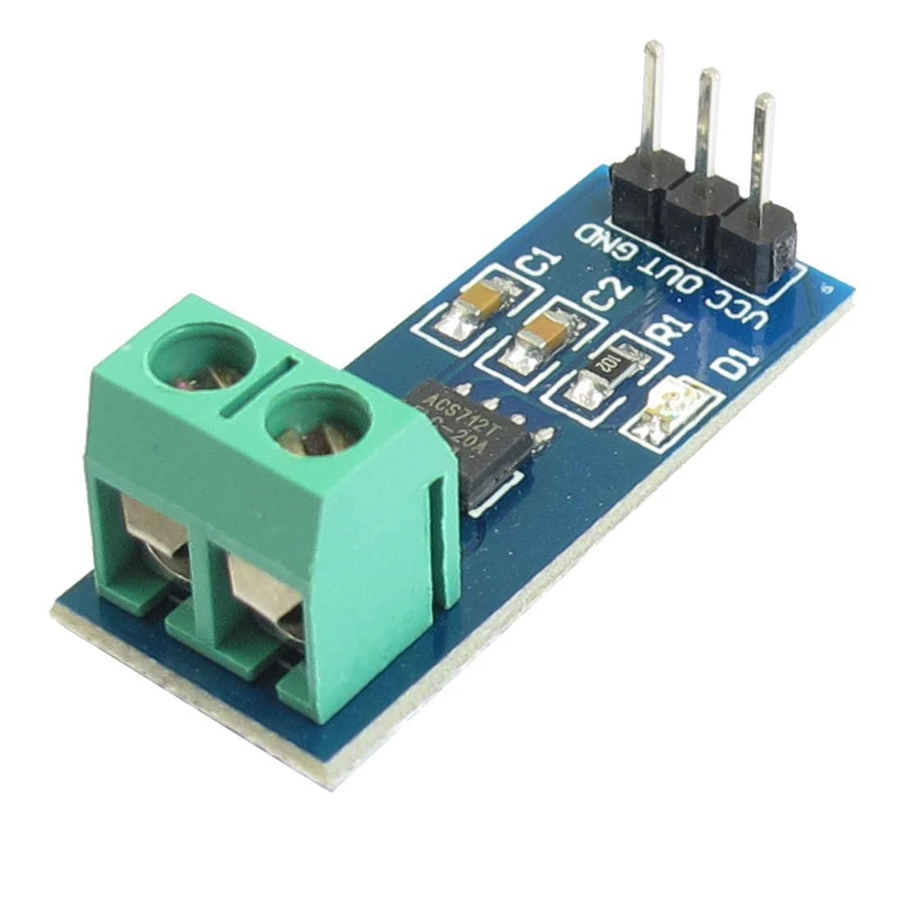
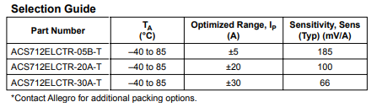
ACS712
Dr. G. V. Prasanna Anjaneyulu
Current Measurement by Dr.GVP

Slide 5
Features and Benefits
Low-noise analog signal path
▪ Device bandwidth is set via the new FILTER pin
▪ 5 μs output rise time in response to step input current
▪ 80 kHz bandwidth
▪ Total output error 1.5% at TA = 25°C
▪ 1.2 mΩ internal conductor resistance
▪ 2.1 kVRMS minimum isolation voltage from pins 1-4 to pins 5-8
▪ 5.0 V, single supply operation
▪ 66 to 185 mV/A output sensitivity
▪ Output voltage proportional to AC or DC currents
▪ Extremely stable output offset voltage
▪ Nearly zero magnetic hysteresis
Dr. G. V. Prasanna Anjaneyulu
Current Measurement by Dr.GVP

Slide 6
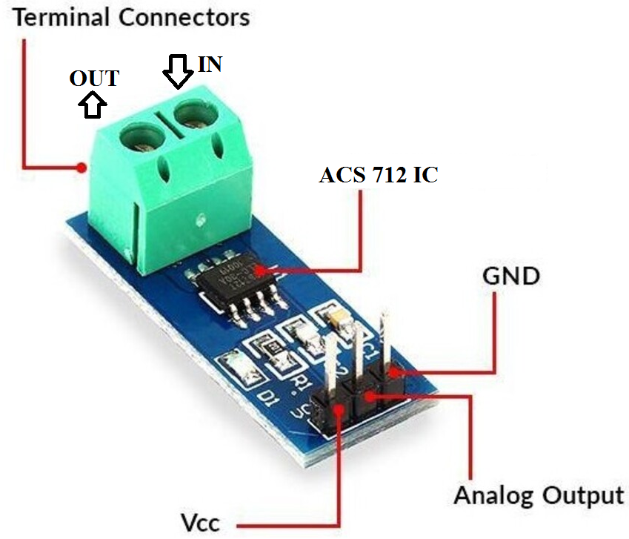
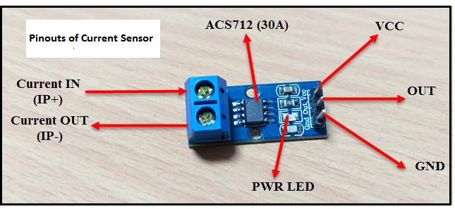
Contd….
Dr. G. V. Prasanna Anjaneyulu
Current Measurement by Dr.GVP

Slide 7
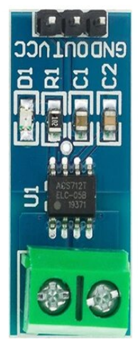
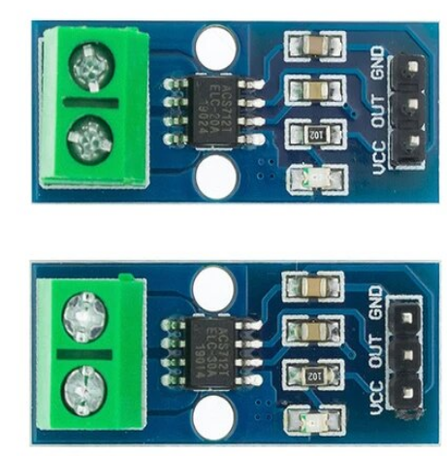
Contd….
Dr. G. V. Prasanna Anjaneyulu
Current Measurement by Dr.GVP

Slide 8
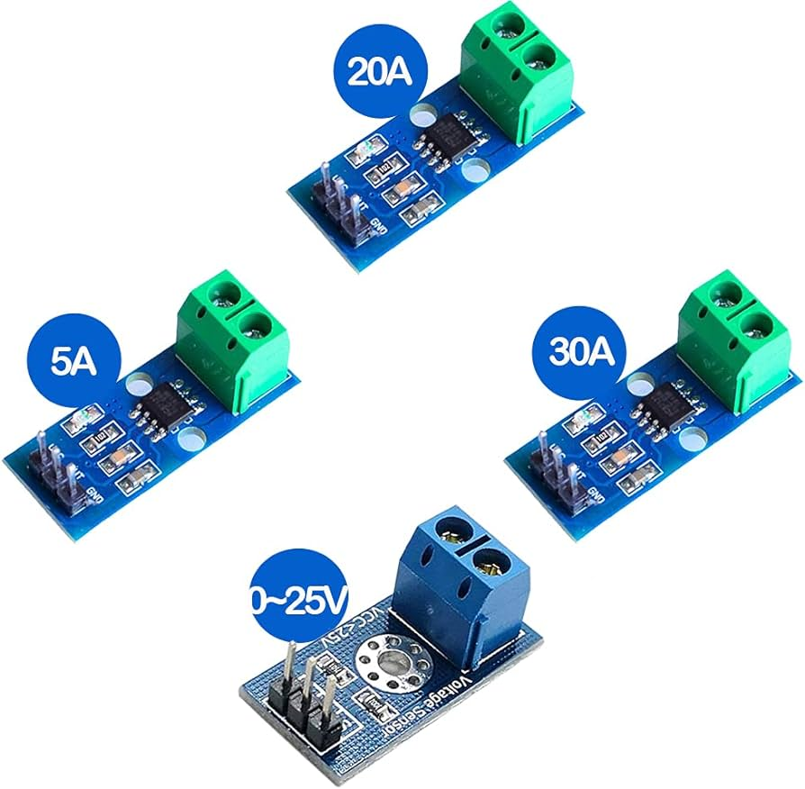
Contd…
Dr. G. V. Prasanna Anjaneyulu
Current Measurement by Dr.GVP

Slide 9
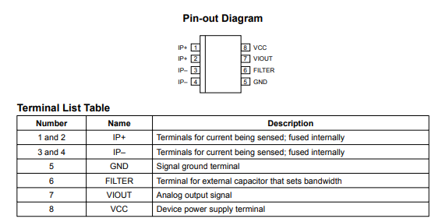
Contd….
Dr. G. V. Prasanna Anjaneyulu
Current Measurement by Dr.GVP

Slide 10
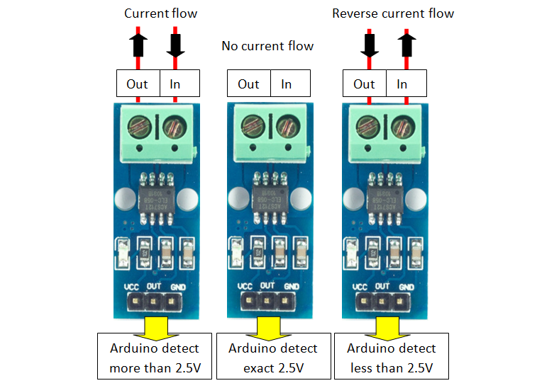
Contd…
Dr. G. V. Prasanna Anjaneyulu
Current Measurement by Dr.GVP

Slide 11
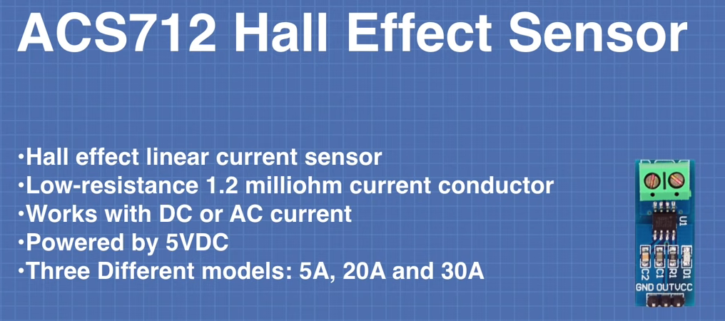
Dr. G. V. Prasanna Anjaneyulu
Current Measurement by Dr.GVP

Slide 12
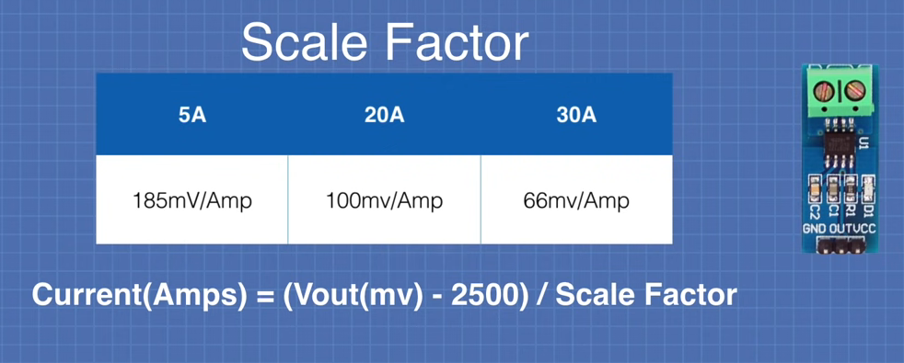
Dr. G. V. Prasanna Anjaneyulu
Current Measurement by Dr.GVP

Slide 13
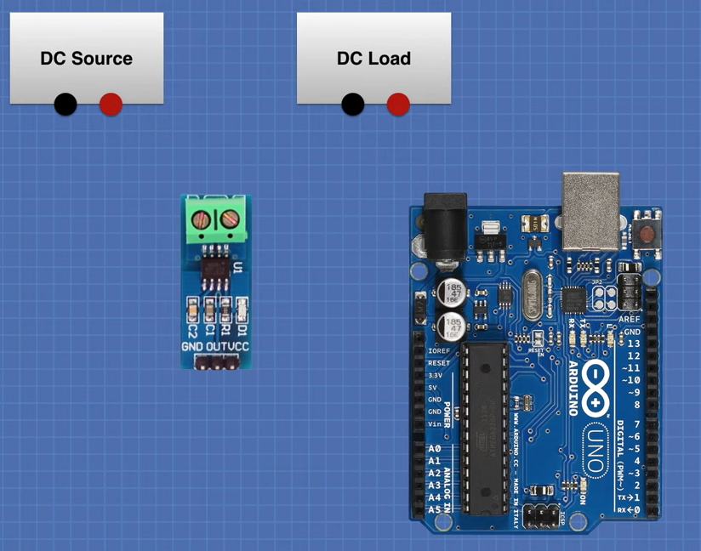
Dr. G. V. Prasanna Anjaneyulu
Current Measurement by Dr.GVP

Slide 14
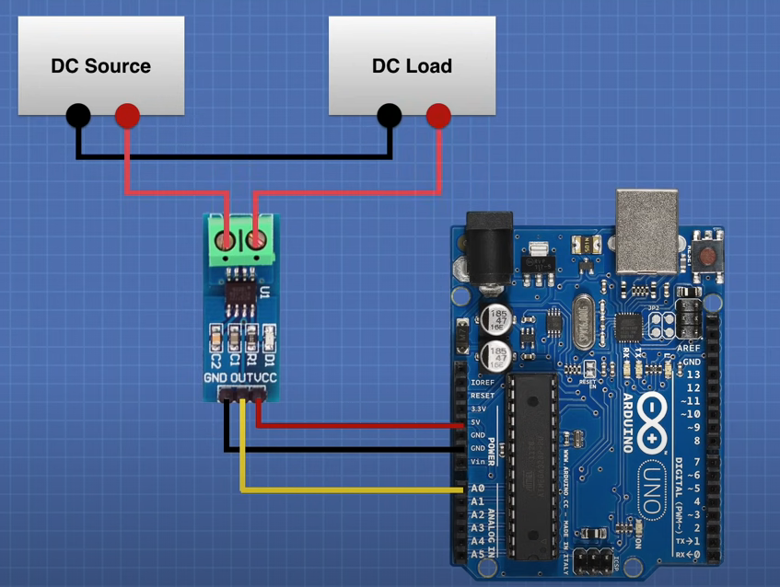
Dr. G. V. Prasanna Anjaneyulu
Current Measurement by Dr.GVP

Slide 15
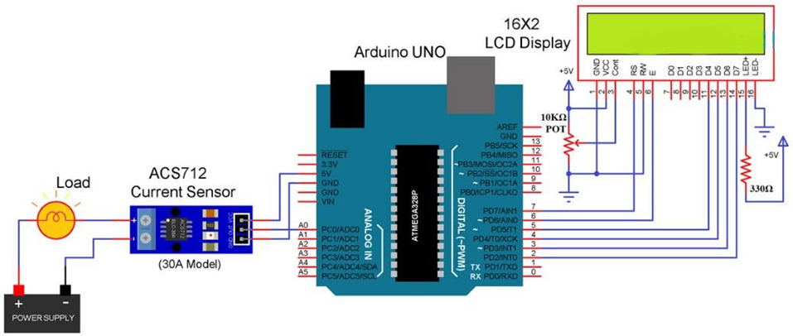
Circuit diagram with 16 x 2 LCD
Dr. G. V. Prasanna Anjaneyulu
Current Measurement by Dr.GVP

Slide 16
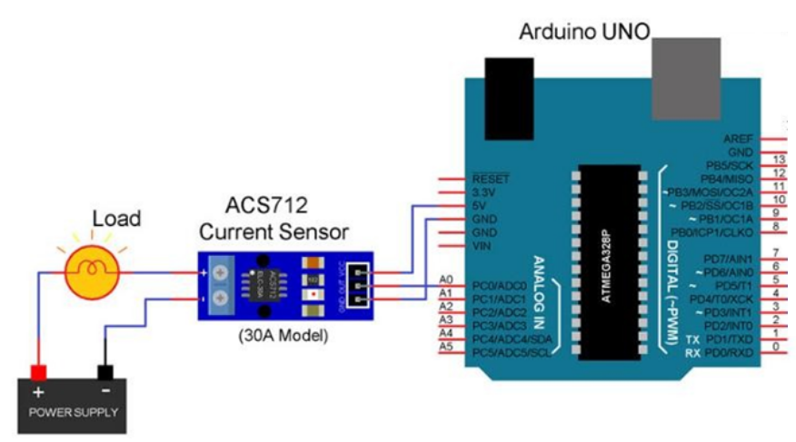
Circuit diagram by without 16 x 2 LCD
Dr. G. V. Prasanna Anjaneyulu
Current Measurement by Dr.GVP

Slide 17
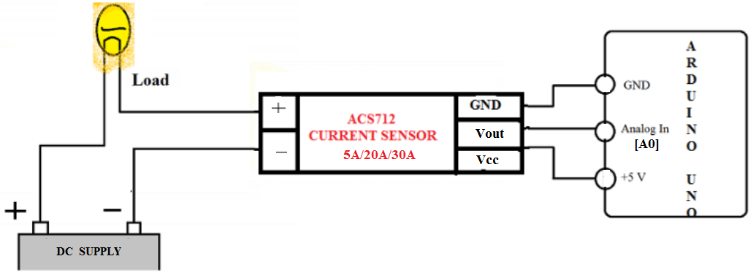
Theoretical circuit
Dr. G. V. Prasanna Anjaneyulu
Current Measurement by Dr.GVP

Slide 18
Program
//Measurement of current with ACS712-30A by ARDUINO
const int currentPin = A0;
int sensitivity = 66; // it for 30A Sensor //for 5A Sensor sensitivity =185
int adcValue= 0;
int offsetVoltage = 2500;
double adcVoltage = 0;
double currentValue = 0;
void setup()
{
Serial.begin(9600);
delay(1000);
}
void loop()
{
adcValue = analogRead(currentPin);
adcVoltage = (adcValue / 1024.0) * 5000;
currentValue = ((adcVoltage - offsetVoltage) / sensitivity);
Serial.print("Sensor Value = " );
Serial.print(adcValue);
delay(2000);
Serial.print("\t Voltage(mV) = ");
Serial.print(adcVoltage,3);
delay(1000);
Serial.print("\t Current = ");
Serial.println(currentValue,3);
delay(1000);
}
Dr. G. V. Prasanna Anjaneyulu
Current Measurement by Dr.GVP

Slide 19
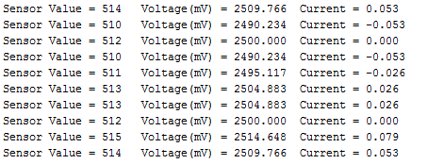
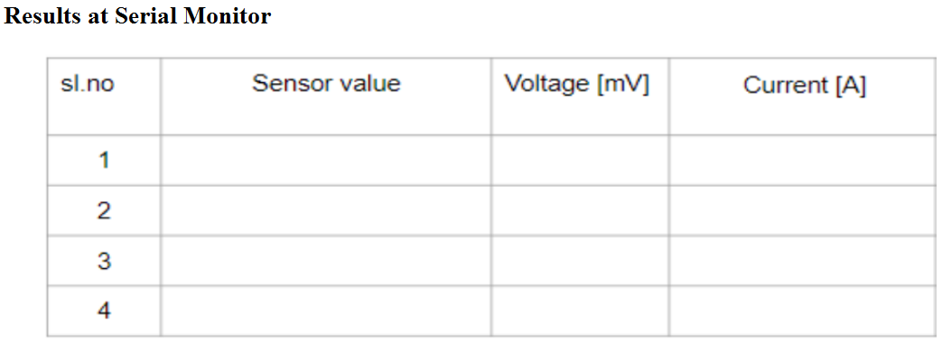
Results
Dr. G. V. Prasanna Anjaneyulu
Current Measurement by Dr.GVP

Slide 20


